Slide 1
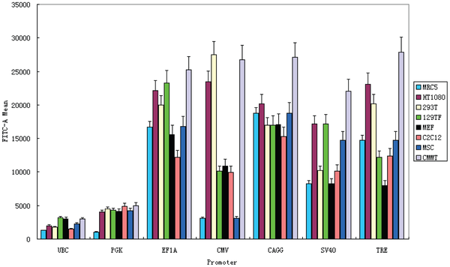

Figure 1. Flow cytometry measurement of GFP fluorescence in eight mammalian cell types transduced with lentiviral vectors carrying GFP reporter driven by promoters of interest.
Qin JY, Zhang L, Clift KL, Hulur I, Xiang AP, et al. (2010) Systematic Comparison of Constitutive Promoters and the Doxycycline-Inducible Promoter. PLOS ONE 5(5): e10611. https://doi.org/10.1371/journal.pone.0010611
https://journals.plos.org/plosone/article?id=10.1371/journal.pone.0010611

